Slide 1
Leaves Classifier
Daniela Florit
Andy D. Martinez

Slide 2
Objective
To develop a leave classifier capable of receiving a picture of a leaf and output its species name or genus name
Play with multiple classifiers to compare performances
Play with multiple feature vectors to compare performances

Slide 3



The Data
Kaggle’s 100 plant leaves dataset
1584 leaf images (binary images)
100 species
34 genus
Table with extracted features

Slide 4
The Project – Stage 1:
Input: Table with features mapped to image id
Output: Predictions for each image
Work done:
Used two classifiers: SVM and Neural Networks
Tuned the classifiers to get best results
Results:
SVM: ~ 10%
Neural Networks: ~ 88%

Slide 5
The Project – Stage 2:
Input: Binary images
Output: Predictions for each image
Work done:
Pre-processed the image:
Found edges, corners, area, perimeter, extreme points, moments, Hu moments, etc
Extracted features
Plotted the features to visualize trends
Created feature vectors:
Combinations of the extracted features
Classified images

Slide 6
Extracted features:
Number of corners
Ratio of length and height of leaf
Ratio of perimeter and area of leaf
Ratio of area of leaf and area of enclosing rectangle
Solidity
Moments
Hu Moments

Slide 7
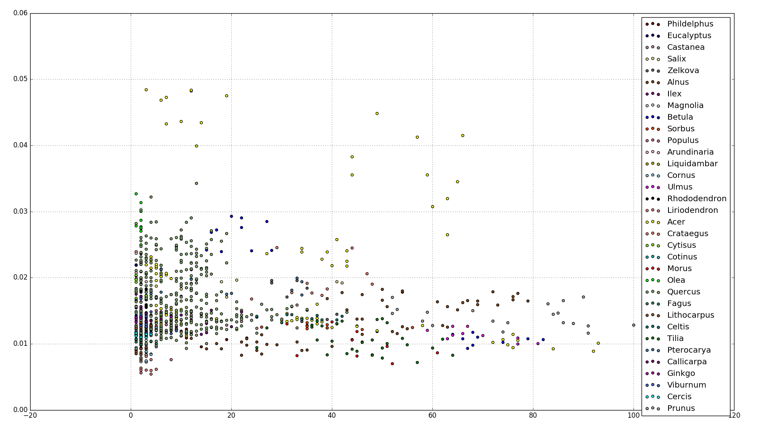
Trends observed:
perimeter_area_ratio
number_corners

Slide 8
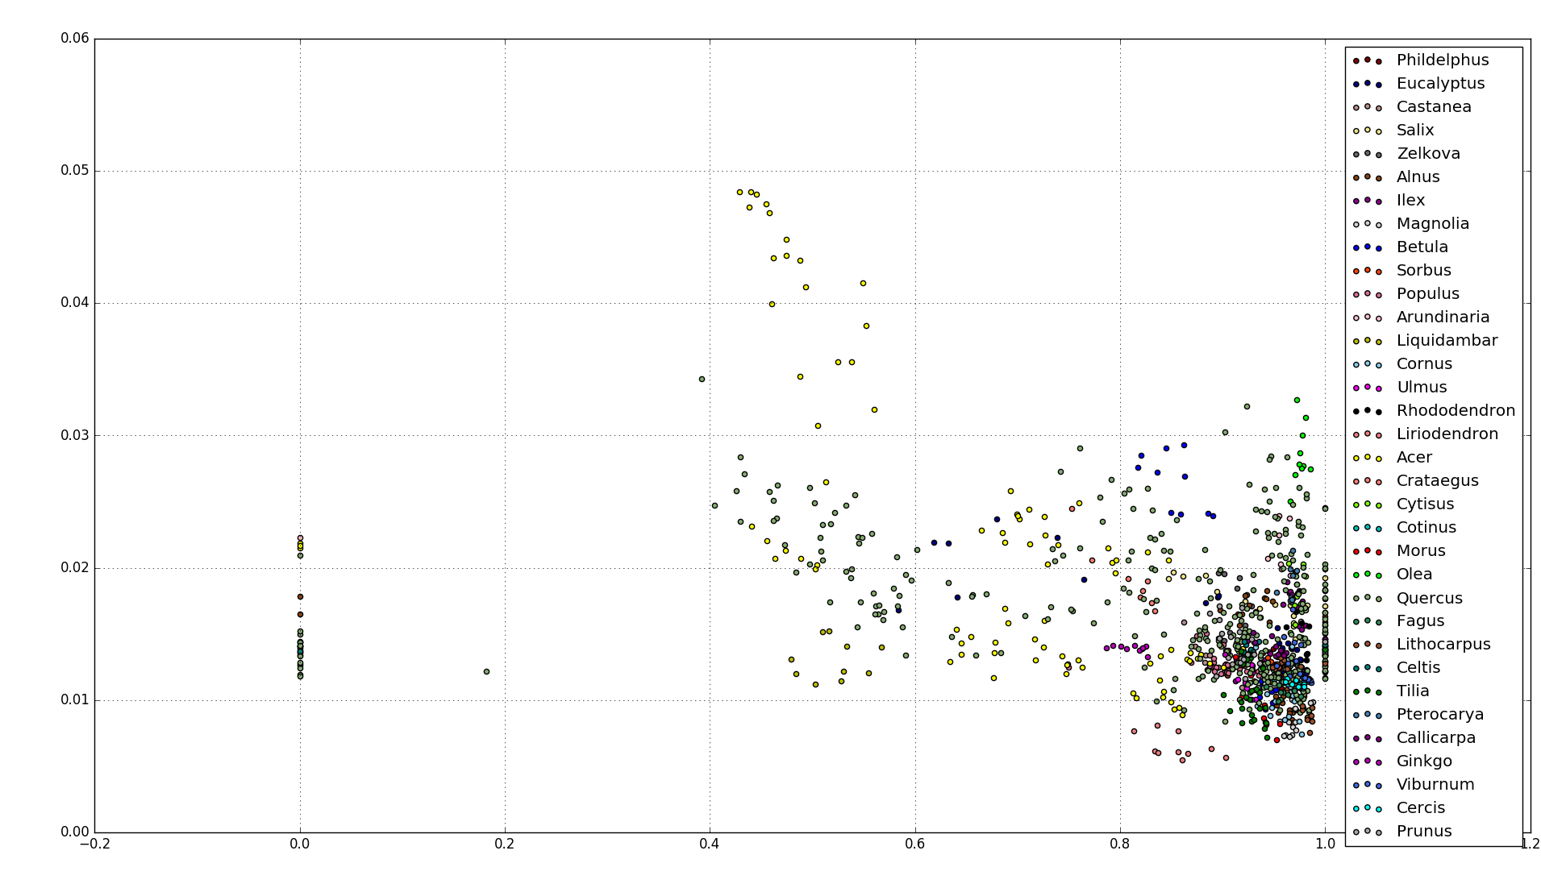
Trends observed:
perimeter_area_ratio
solidity

Slide 9
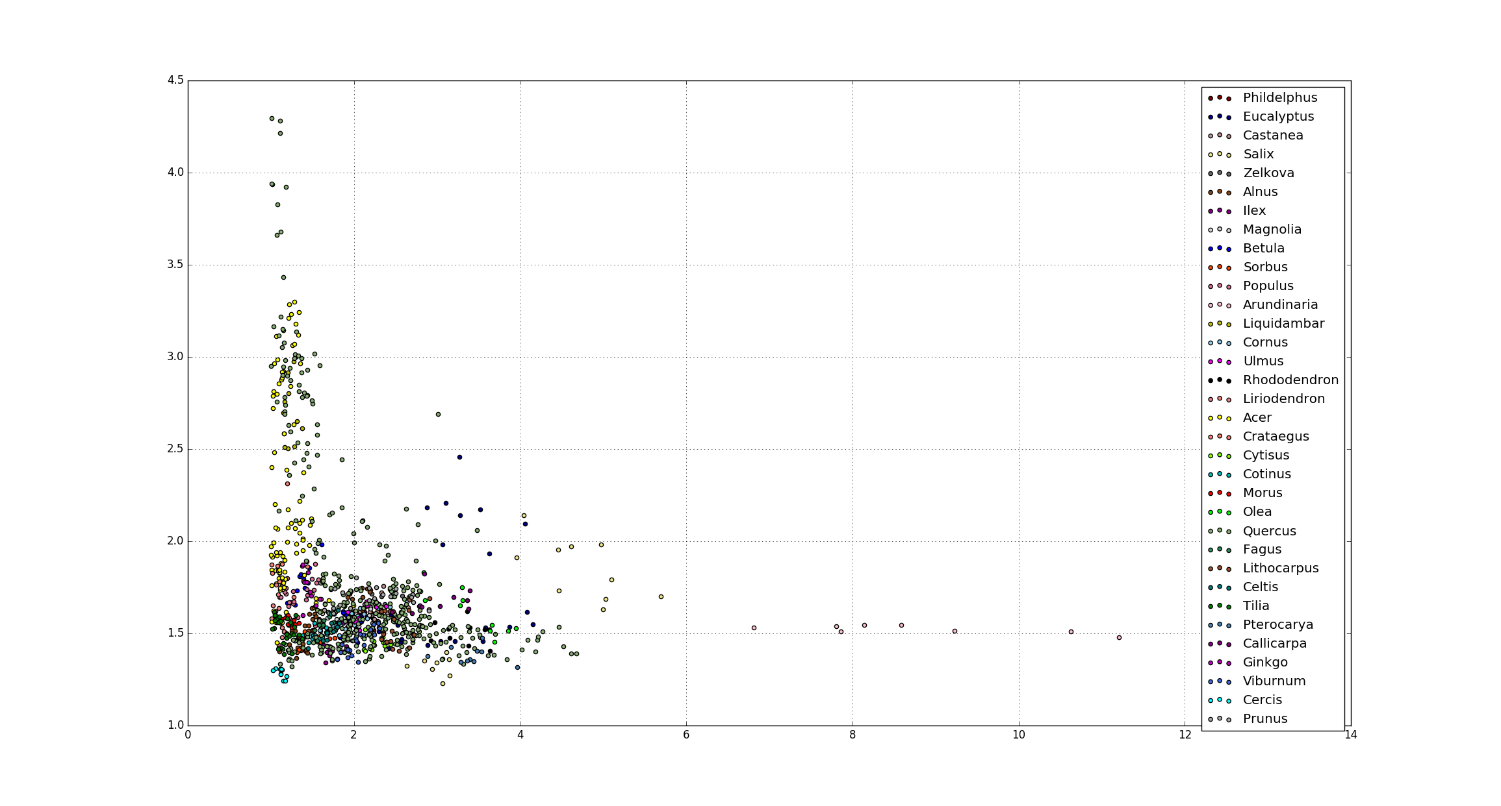
Trends observed:
ratio_of_areas
length_width_ratio

Slide 10
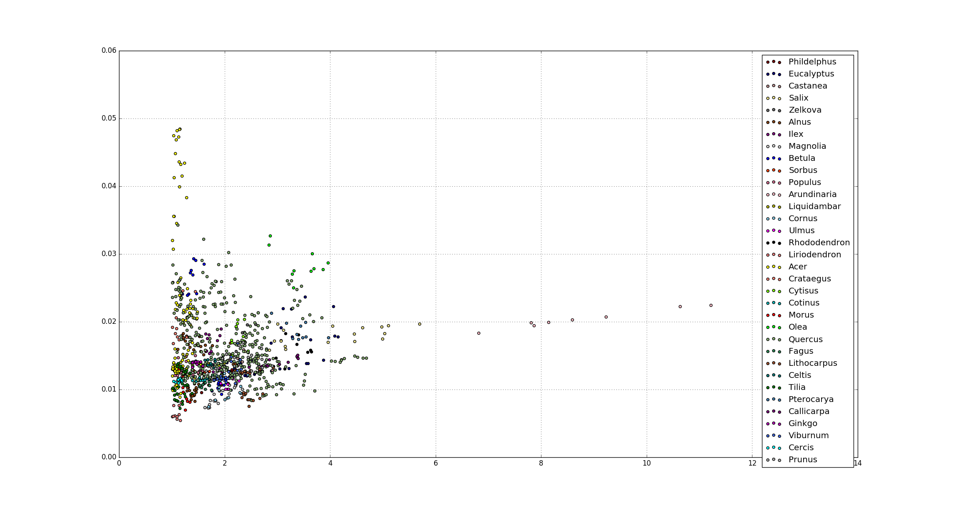
Trends observed:
perimeter_area_ratio
length_width_ratio

Slide 11
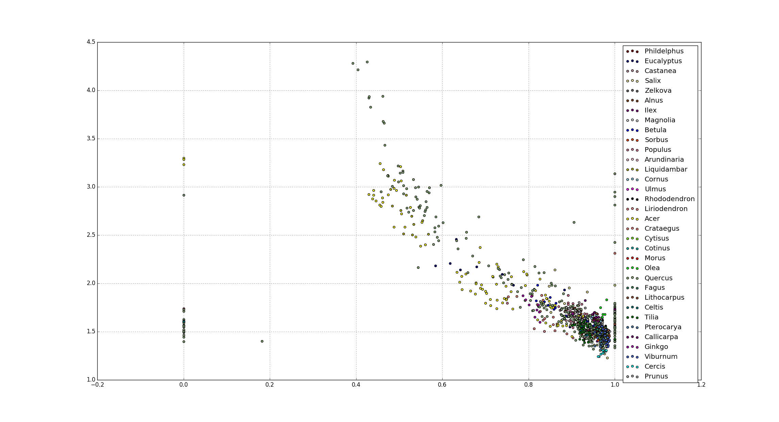
Trends observed:
ratio_of_areas
solidity

Slide 12
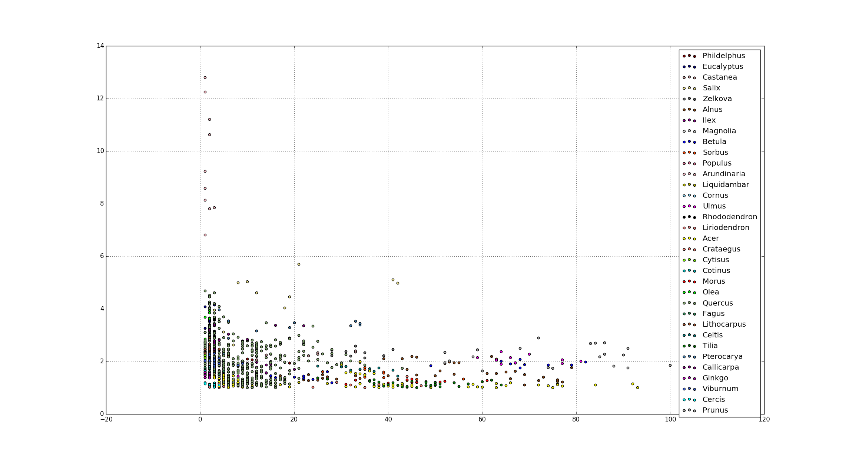
Trends observed:
length_width_ratio
number_corners

Slide 13
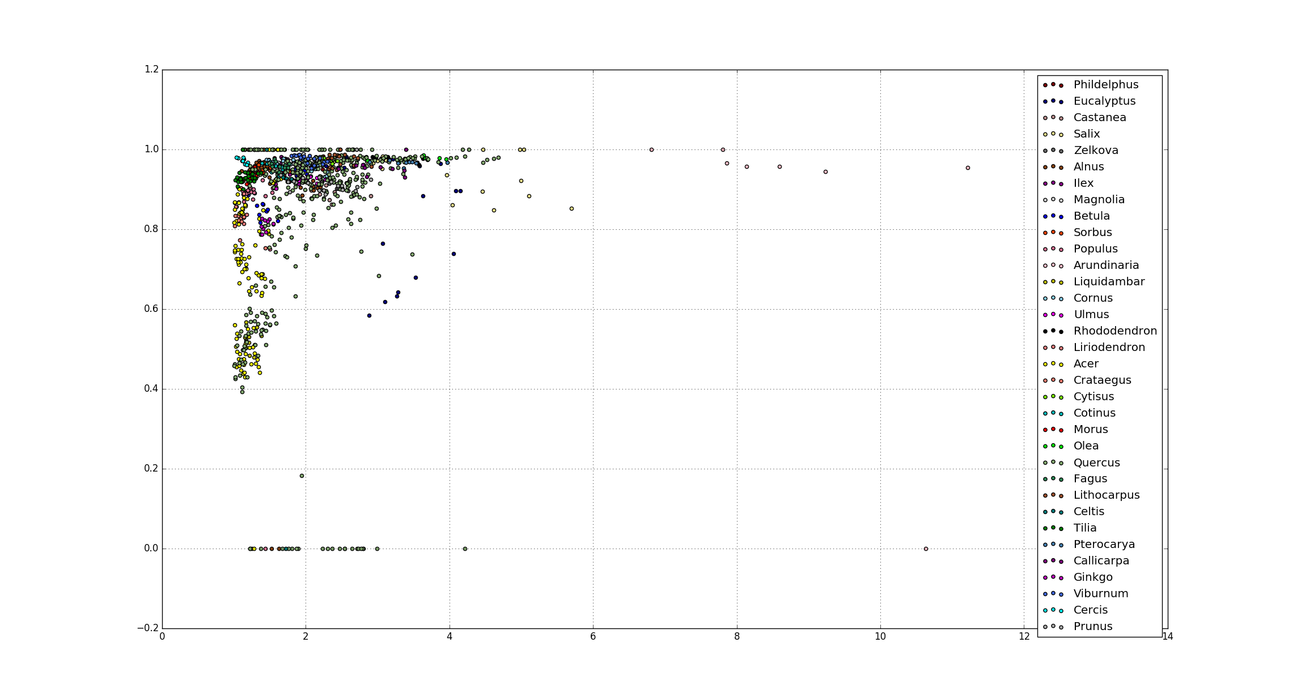
Trends observed:
solidity
length_width_ratio

Slide 14
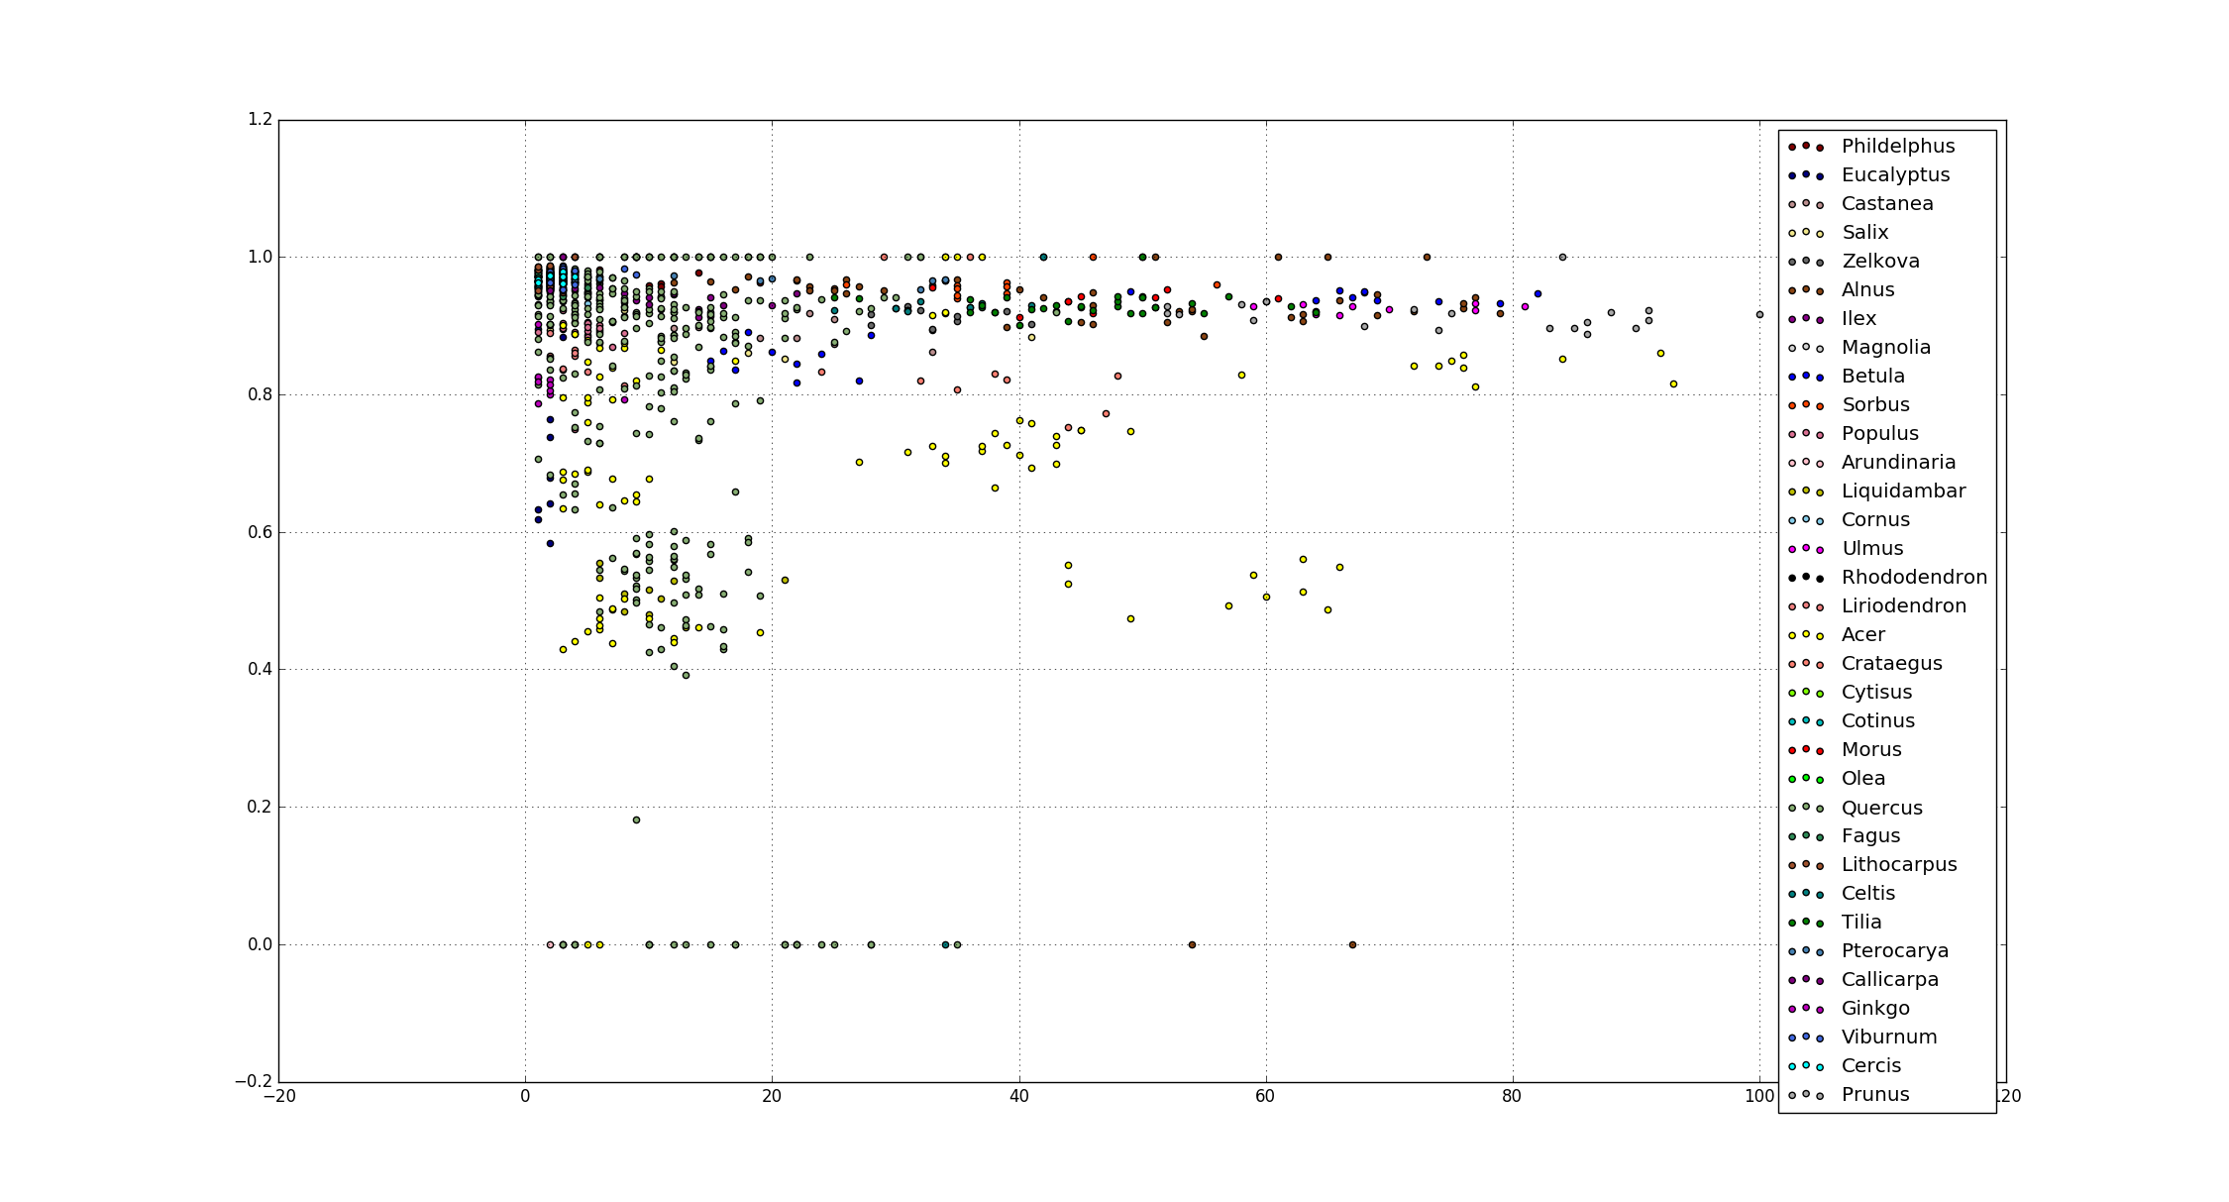
Trends observed:
solidity
number_corners

Slide 15
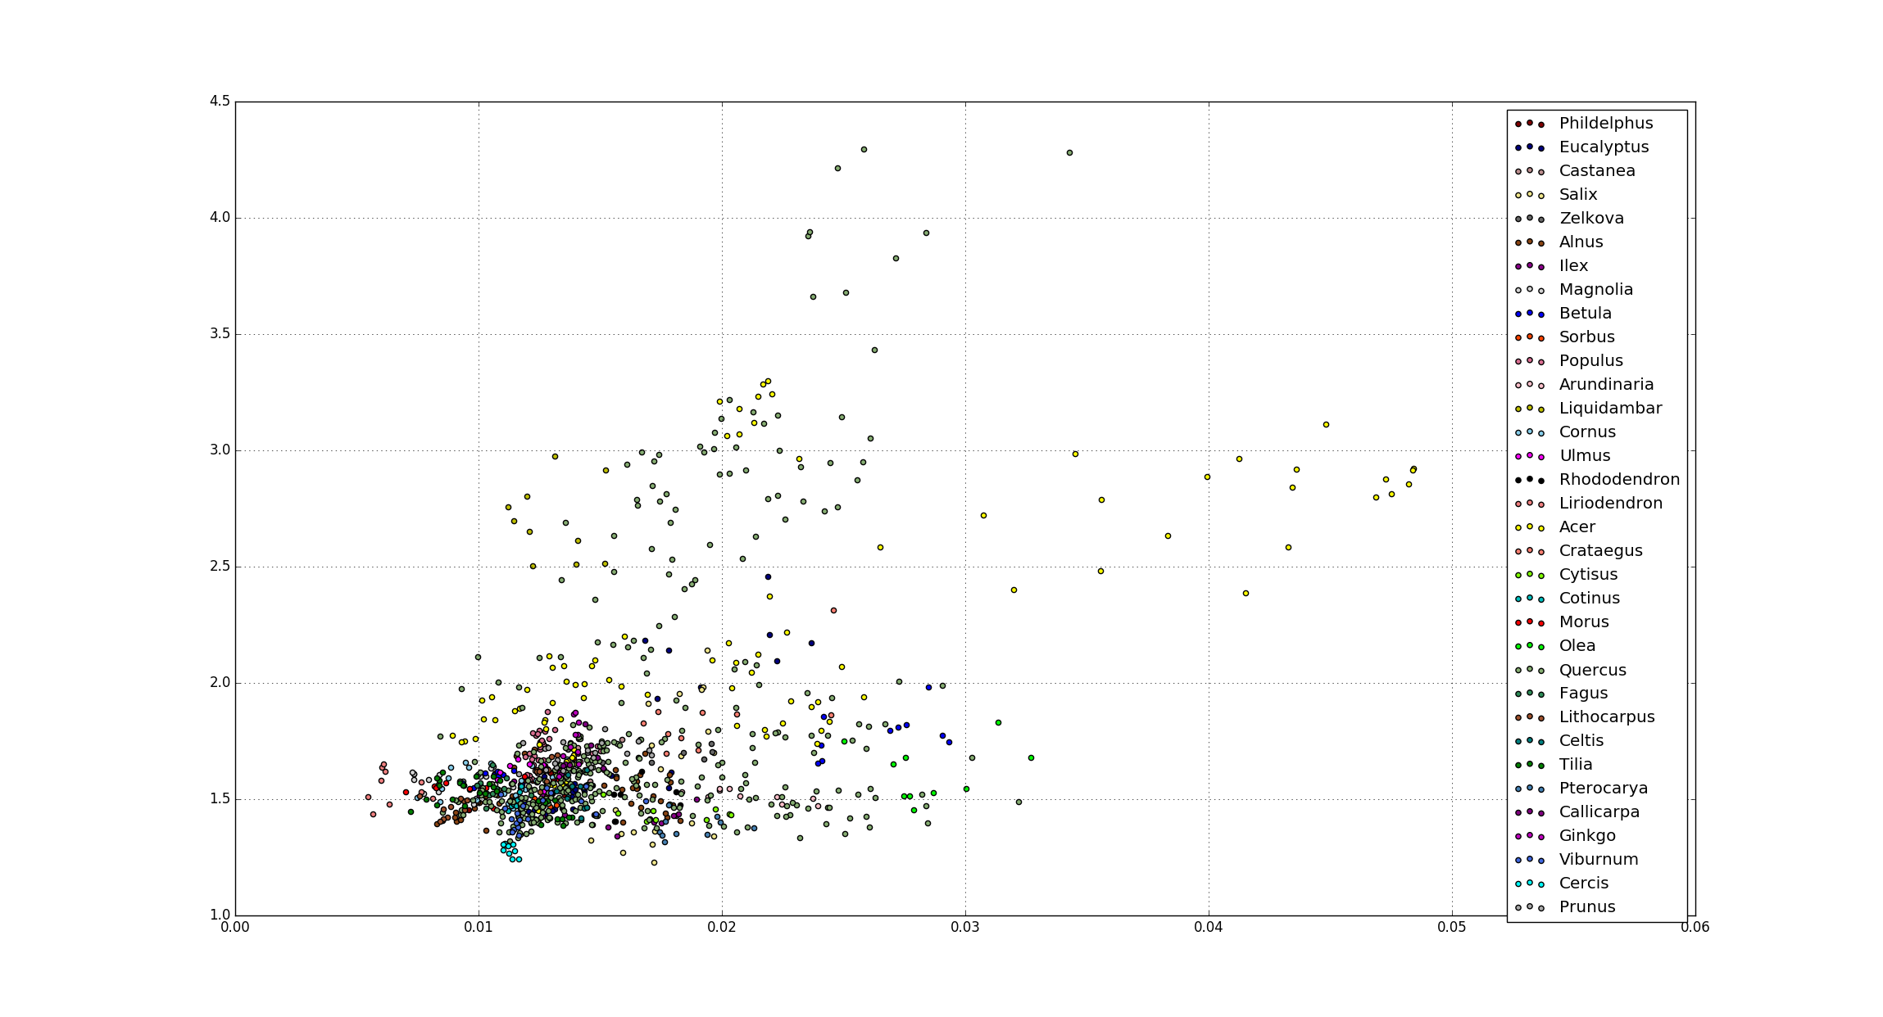
Trends observed:
ratio_of_areas
perimeter_area_ratio

Slide 16
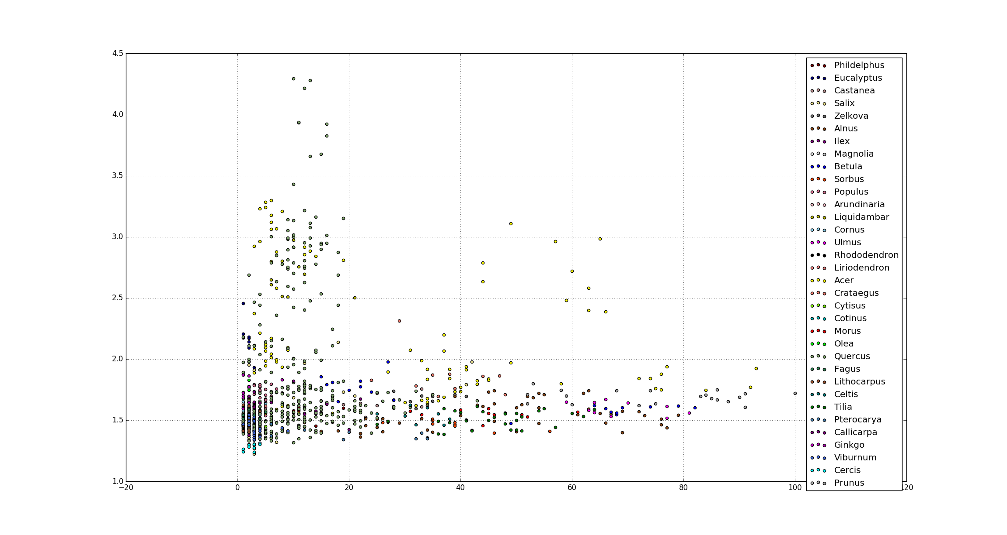
Trends observed:
ratio_of_areas
number_corners

Slide 17
Results:
Ex. | Classifier | Feature extractor | Classification Type | Accuracy
1 | SVM | all | species | 2%
2 | SVM | No moments | species | 13%
3 | SVM | all | genus | 36%
4 | SVM | No moments | genus | 44%
5 | NN | all | species | 1%
6 | NN | all | genus | 20%
7 | NN | No moments | species | 25%
8 | NN | No moments | genus | 55%

Slide 18

Limitations:
Only Binary images in the dataset
Limited amount of training data for 100 categories

Slide 19
The Project – Stage 3:
Input: Color images from internet
Output: Predictions for each image
Work done:
Pre-processed the color image:
Convert to binary image using contours and entropy
Pre-processed the binary images
Extracted features
Created feature vectors
Classified images

Slide 20
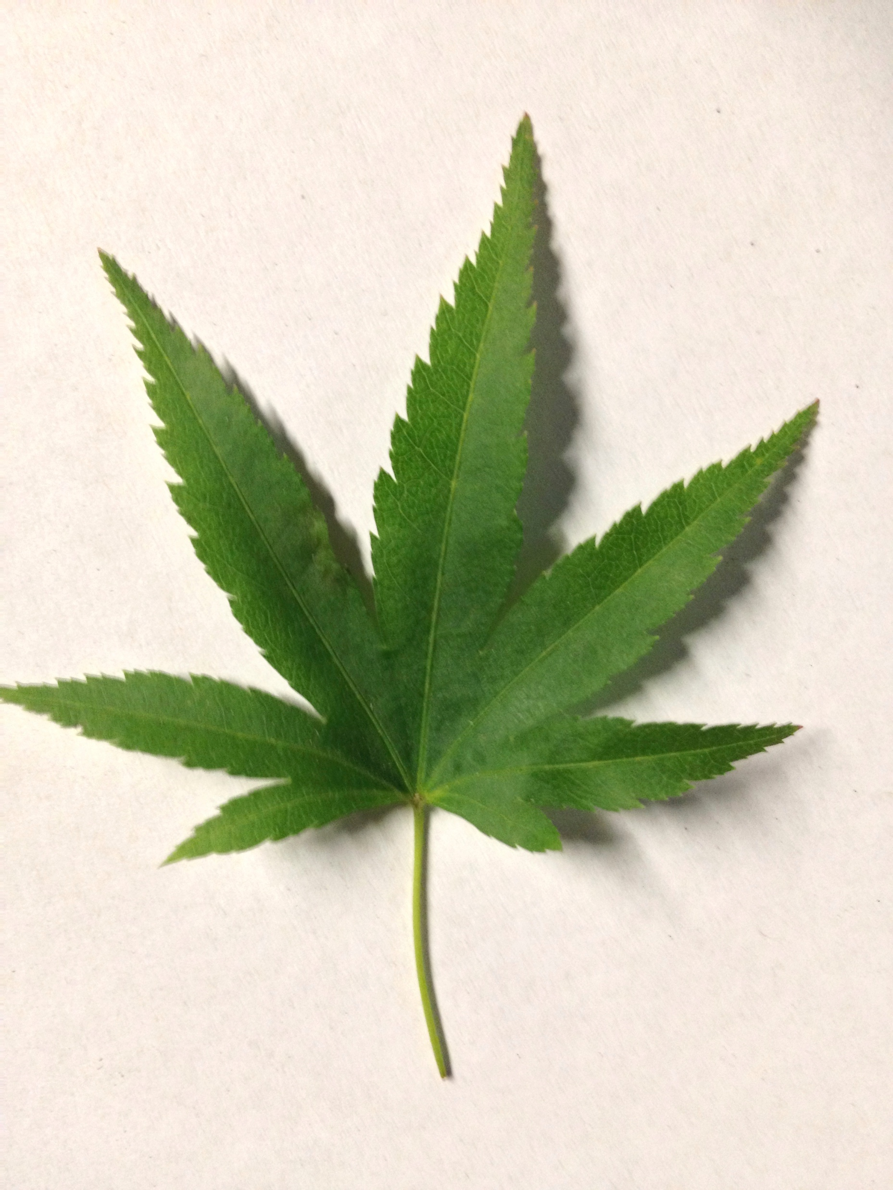

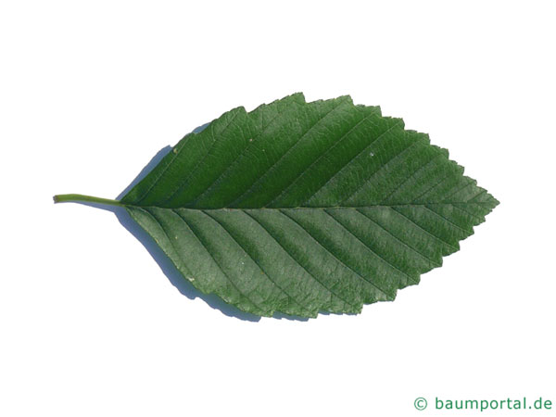
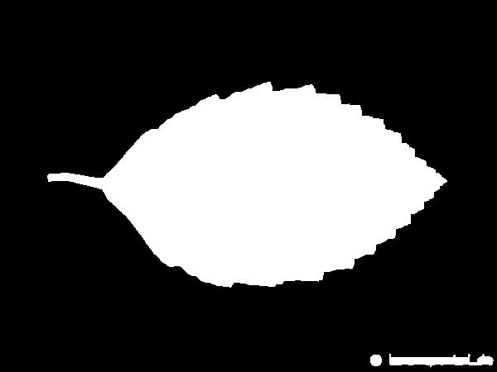
Results:
Label: Acer palmatum
Prediction: Acer
Success
Label: Alnus Rubra
Prediction: Alnus
Success

Slide 21
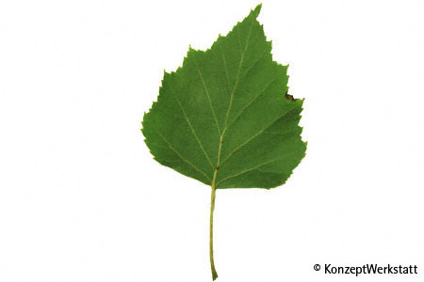
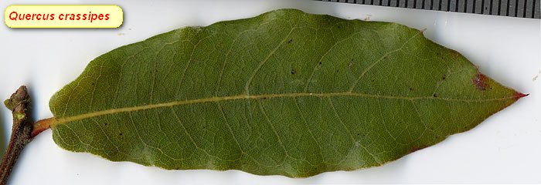


Results:
Label: Quercus Crassipes
Prediction: Quercus
Success
Label: Betula Pendula
Prediction: Quercus
No Success

Slide 22
Future goals:
Find color dataset
Increment feature vector size
Use deep learning
Move it to an mobile application

